Slide 1
1 – 2 – 3
It’s Easy to Vote!
Portions adapted from easyvoterguide.org

Slide 2
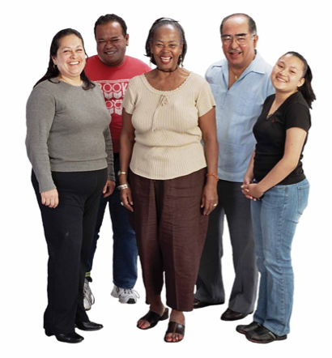
Can you vote?
Voting is as easy
as 1 – 2 – 3!
- Are you a US citizen?
- Are you 18 years
old or older?
If yes, then you can vote.
Most images are from www.easyvoterguide.org

Slide 3
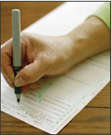
1. Sign up.
Register.
Register at least
15 days before
an election.
You can get a form
* at the library
* at the post office
* at City Hall
or call 1-800-345-8683

Slide 4
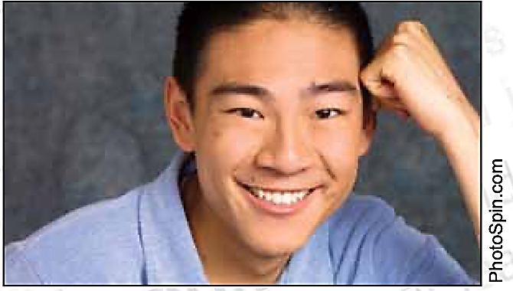
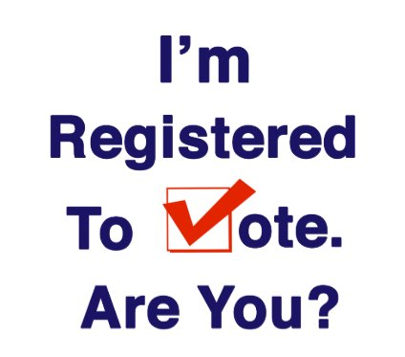
Image from www.easyvoterguide.org
Zazzle sticker

Slide 5
2. Get Ready to Vote
Learn about the people who are running
for office and about the propositions.
(You don’t need to vote for every office
or for every proposition. You can just vote
on what is important to you.)
Get information from Easy Voter Guide https://easyvoterguide.org
Image from www.easyvoterguide.org

Slide 6
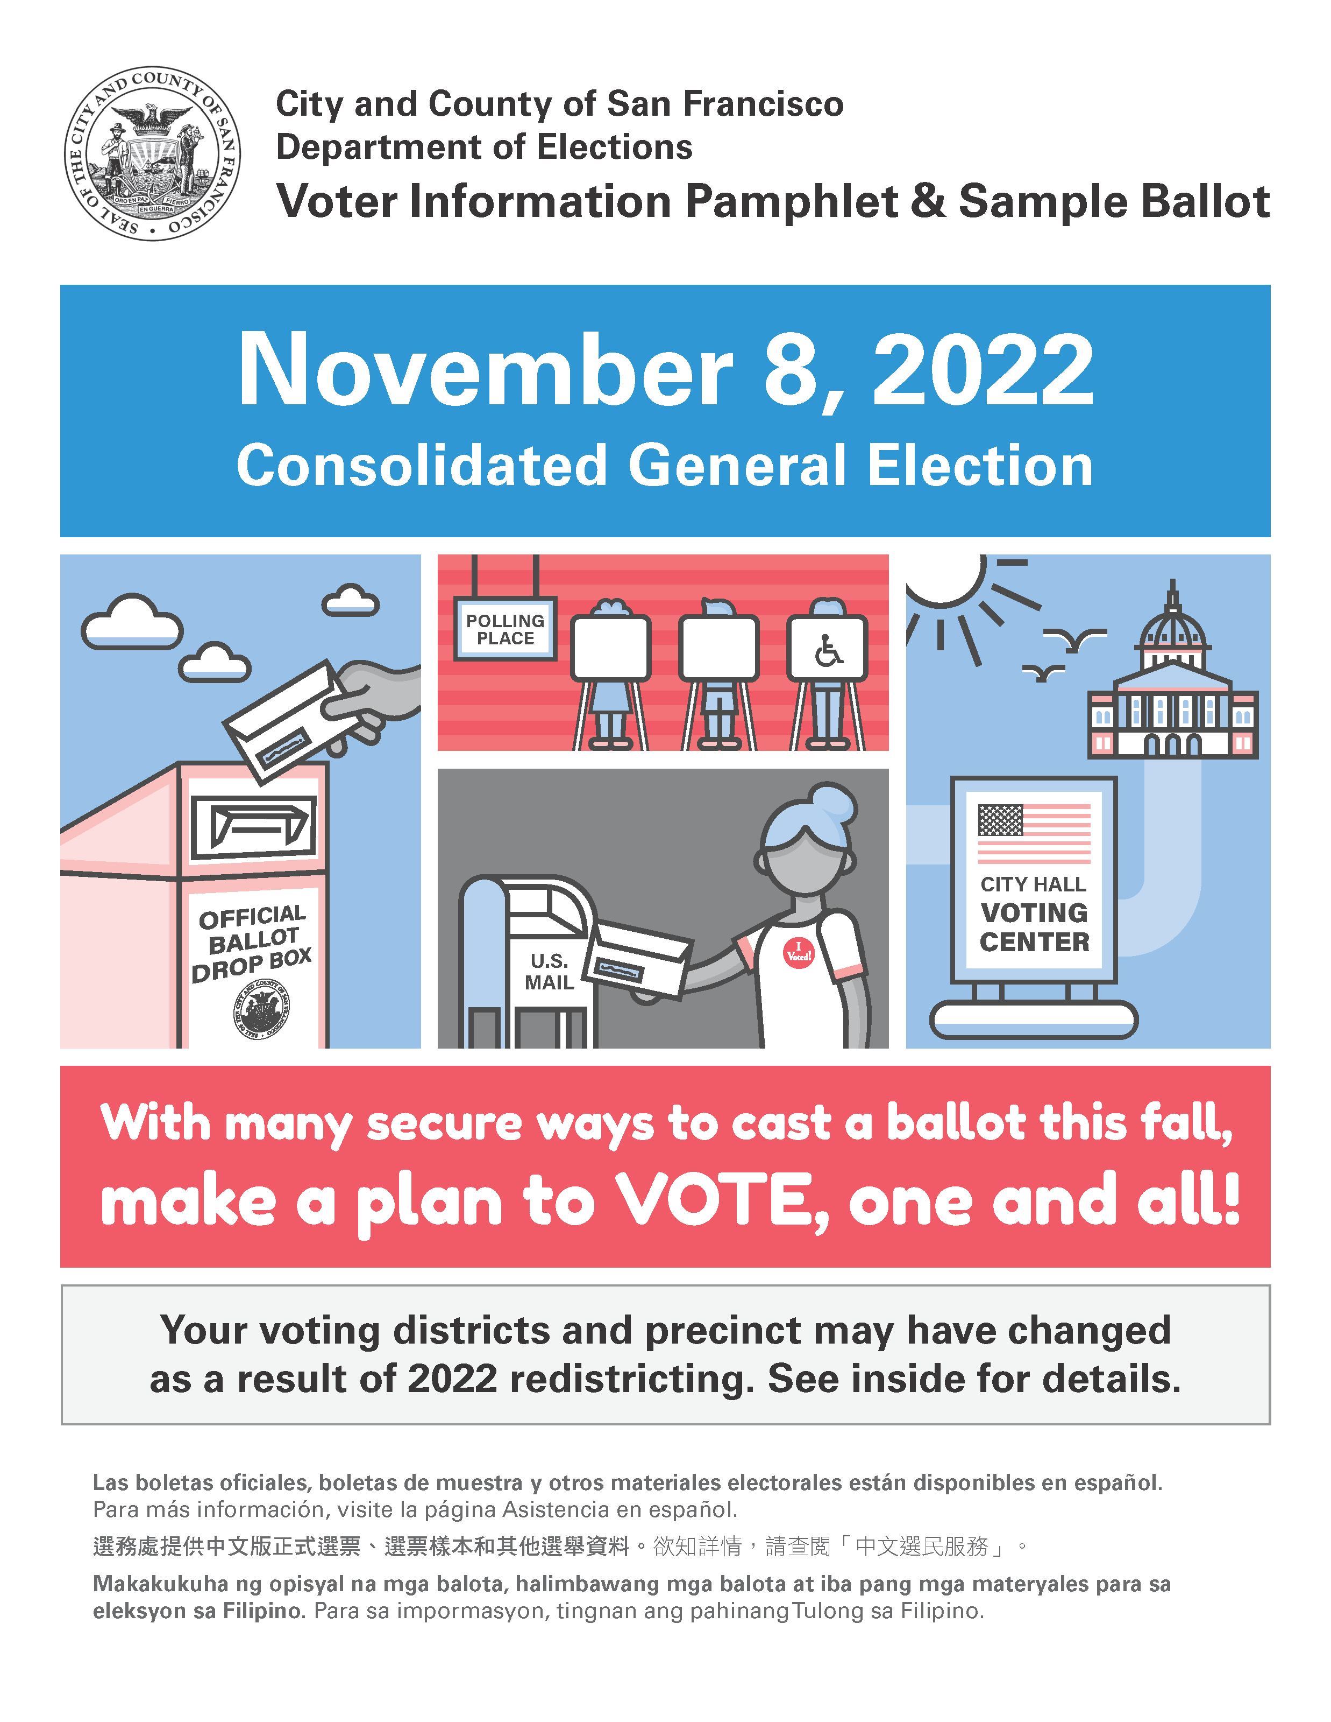
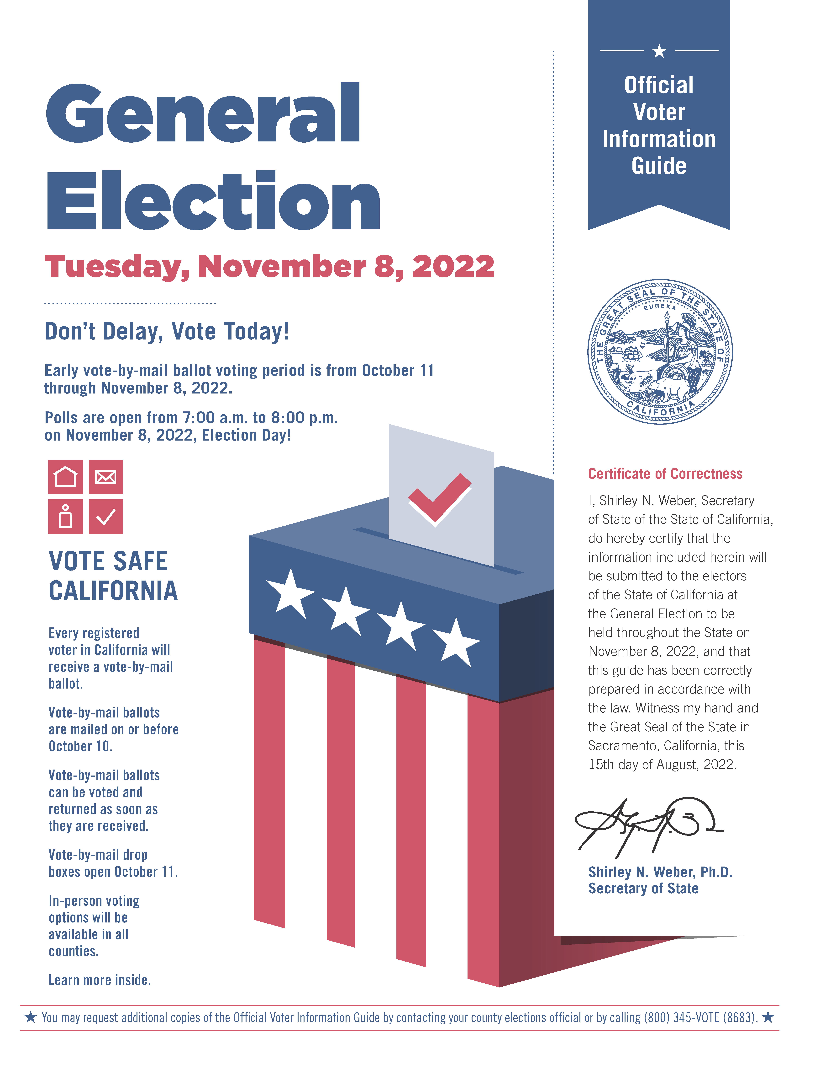
To help you prepare, all registered voters
get two booklets in the mail:
Example of Sample Ballot and
Voter Information Pamphlet
Example of a
Voter Information Guide

Slide 7
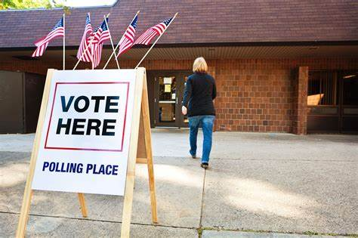
3. Decide how you will vote.
You can choose if you want to vote:
A) At your polling place on election day
Look at the back cover of the
Sample Ballot to find your polling place.

Slide 8
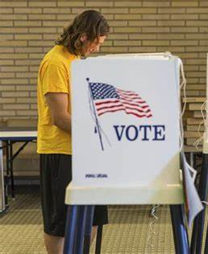
Vote!
Two Images from www.easyvoterguide.org

Slide 9
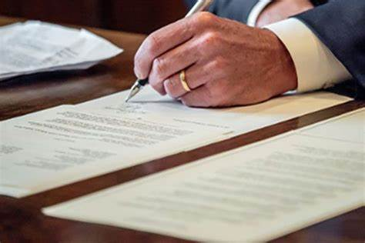
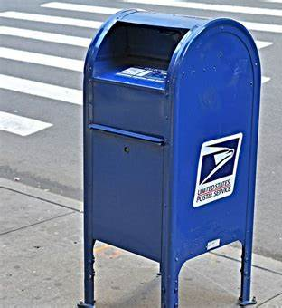
Or, B)
You can vote early.
You can vote at home with a “vote by mail” ballot.
Sign and mail in your ballot.

Slide 10
1 – 2 – 3
It’s Easy to Vote!
Portions adapted from easyvoterguide.org

